Slide 1
CAPA Youth Team Orientation
CAPA Youth Team Orientation
9/03/2021

Slide 2
Orientation Agenda
Introduction
CAPA Board Members
CAPA Youth Team Mission Statement
How to Apply for PVSA through CAPA
CAPA Volunteer Hour Rules
CAPA Youth Team Events
Be your own Project Leader
Q & A

Slide 3
Why CAPA Youth Team?
Opportunity to learn and grow
Build up leadership
Get to know yourself better
Volunteer work is not just for hours
Special Guest: Dr. Tony Torng - WVUSD School Board Vice President, District Board of Trustees, PhD.

Slide 4
CAPA Board Members for 2021 - 2022
Cindy Huang - CAPA President
Caren Ho - Vice President
Brian Lin -Vice President
Cindy Xia -Secretary
Selina Huang -Treasurer
Jason Wang - Web Master
Taiping Sun, Linda Cao, Marris Chen - Coordinator

Slide 5
CAPA Youth Team Mission Statement
Our Mission is to educate students through various volunteer opportunities. We hope to give back to our communities through various types of services, and help our students get a deeper and more full understanding of the power of philanthropy.
Notes:
Good Evening everyone, my name is Ethan Yang and I am a current senior at Diamond Bar High school, as well as one of the student team leaders for the CAPA youth team. Unfortunately, due to time conflicts I am unable to be present during this meeting, so I will cover my slides through this video. So here we have our CAPA Youth team Mission Statement.

Slide 6
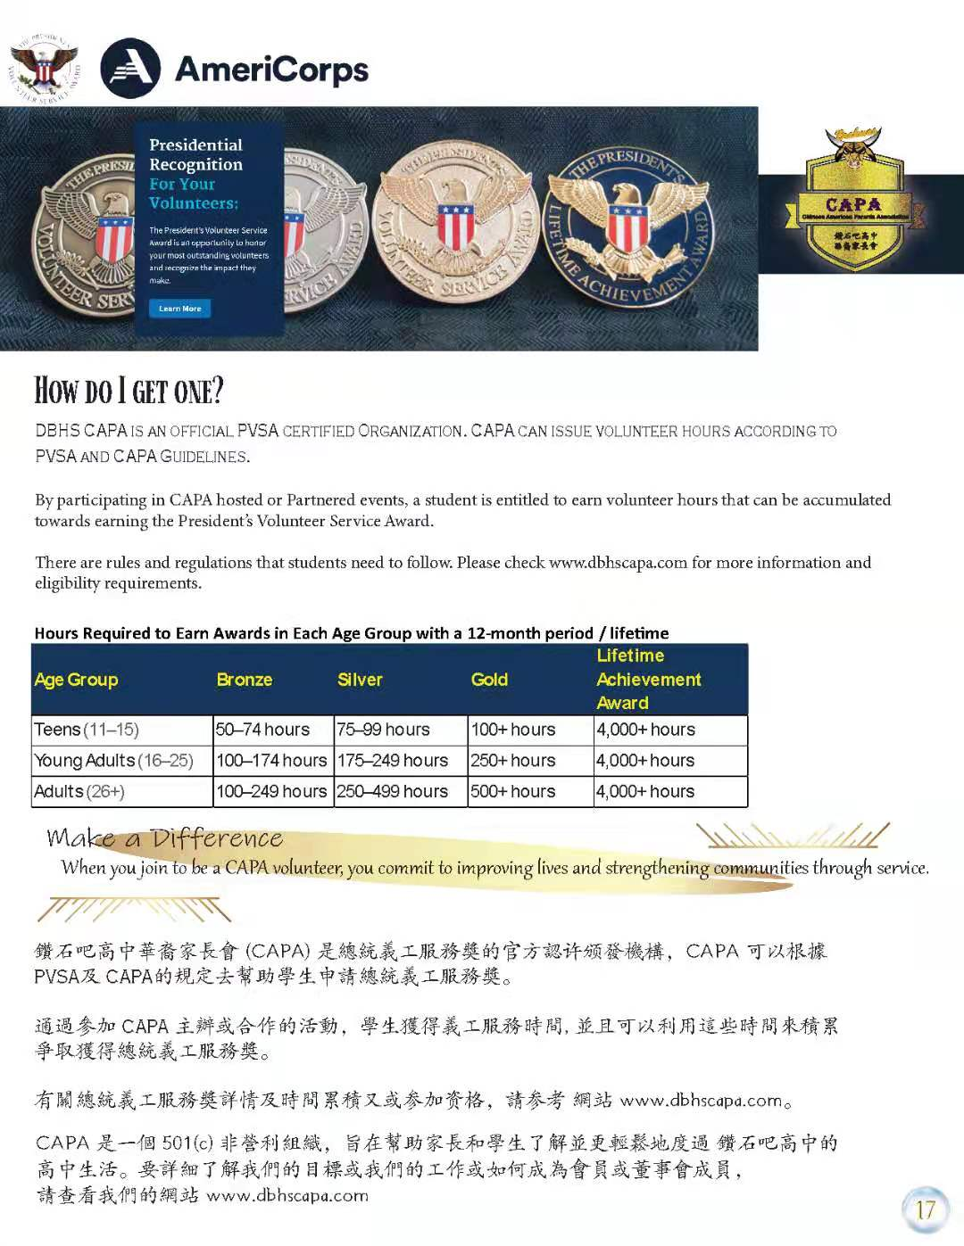
How to apply PVSA from CAPA:
Qualification
Cost
CAPA Volunteer Hour Rule
Valid through 5/31/2022
Please check www. dbhscapa.com for more information
Notes:
Ethan So how do you apply to the PVSA through CAPA? The PVSA, or President’s Volunteer Service Award has some prerequisites that students will need to fulfill before applying.
To Qualify, applicants must be U.S. citizens or lawfully admitted permanent U.S. residents.
Students will have to pay the nominal cost of PVSA awards, and that includes shipping.
CAPA Volunteer Hour Rule:
CAPA Youth Team events only available for CAPA family members
CAPA does NOT accept volunteer hours outside of the organization
CAPA volunteer certifications will be issued REGARDLESS of hour count - These volunteer hours will be valid until May 31st 2022, so make sure you keep track of the calendar!
Please check www. dbhscapa.com for more information

Slide 7
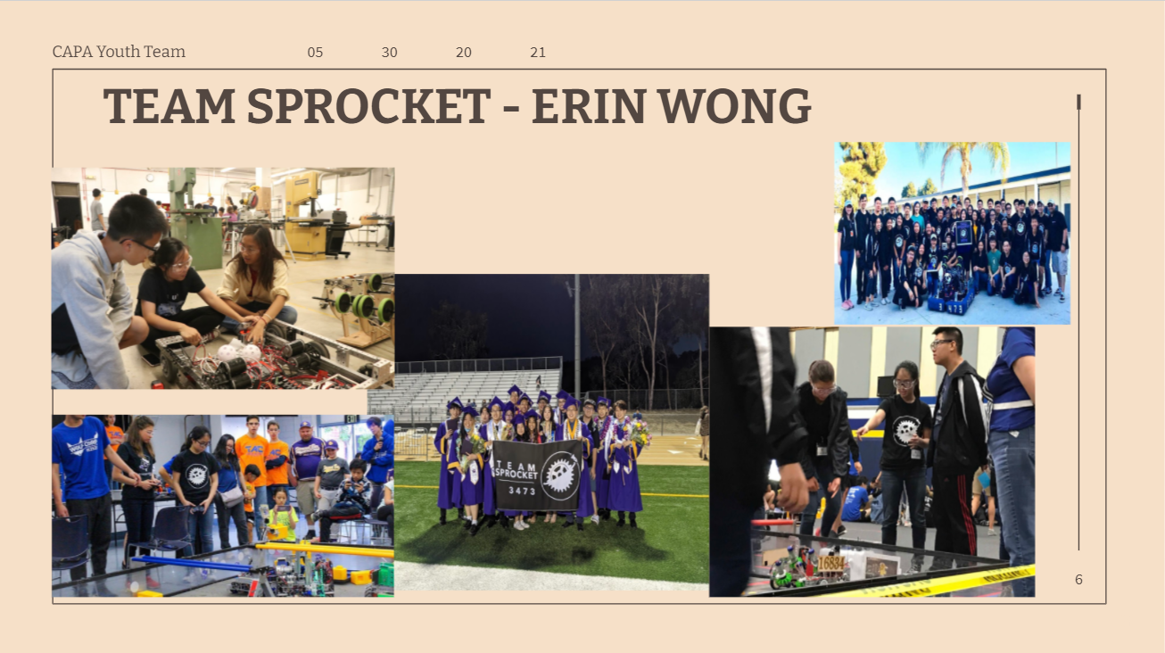
Middle Schools Seminars
DBHS CLUB PRESENTATIONS
Notes:
These presentations were led by student team leaders and their various guests, who held different positions within their clubs. The idea of these club presentations was to showcase the clubs that are available within DBHS, so incoming students do not feel overwhelmed when Club Rush begins. Parents and incoming high schoolers attend these club presentations. From robotics to esports, DBHS holds a wide variety of clubs within their campus. Come check them out!

Slide 8
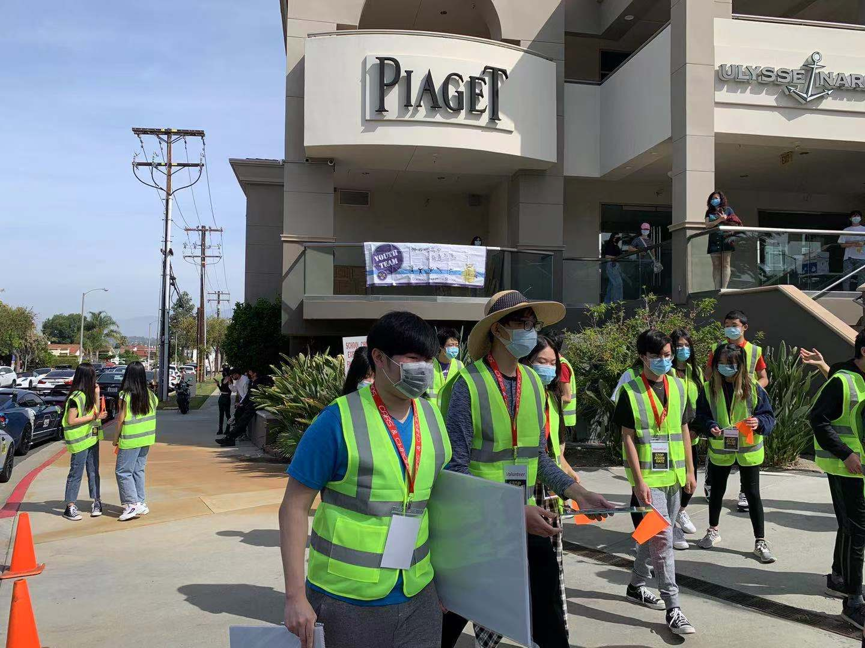
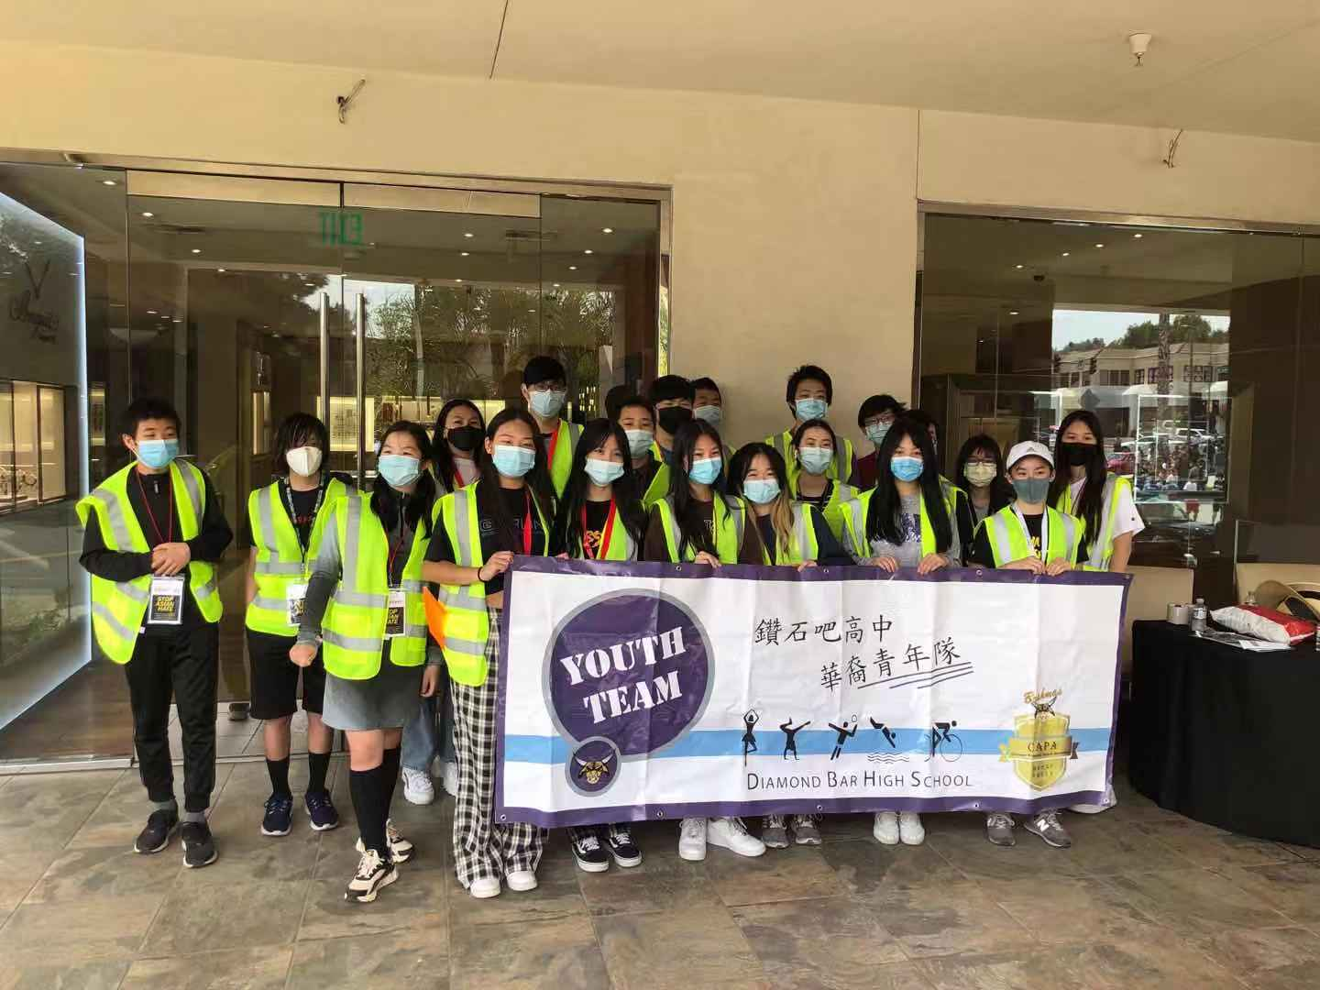
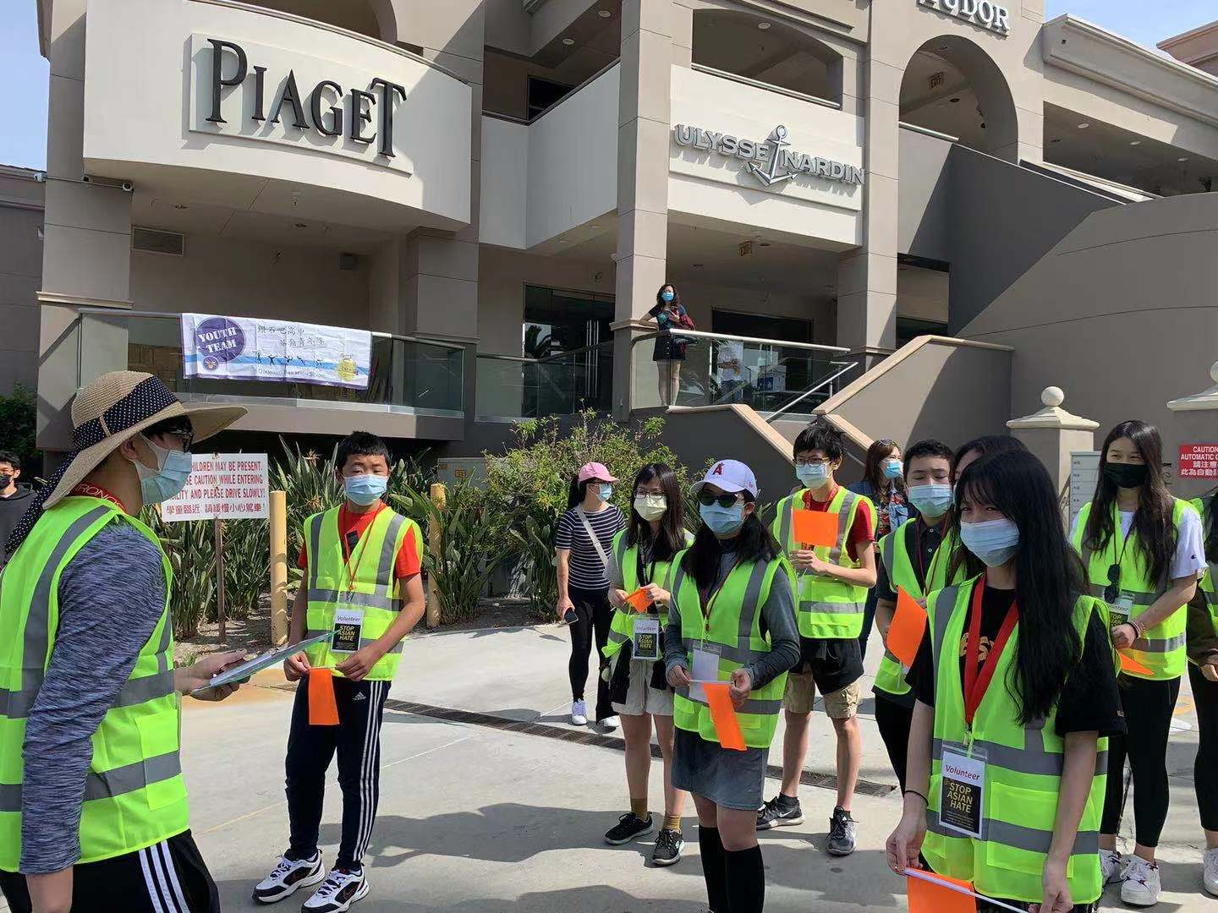
School and Off-Campus Events
Stop Asian Hate Rally - May 2021
Notes:
Our first but definitely not last off-campus event was the Stop Asian Hate Rally on May 1st, 2021. During this event, CAPA volunteers helped direct the flow of incoming traffic due to the rally. This multi-hour operation was a huge success, with the control of over 300 vehicles handled perfectly due to our amazing volunteers. We look forward to helping out in future events like this, so keep your eyes and ears open to any updates!

Slide 9
Little Parrot Farm x CAPA Internship Program
Overview - 5 modules; 4 -6 weeks each
Must complete fall module to receive volunteer hours
Registration is required
Covid-19 vaccination
Allergies
Garden gloves
Preferred dress code
Notes:
Overview - 5 modules; 4 -6 weeks each
Must complete fall module to receive volunteer hours
Registration is required -> Google Form on CAPA website, 100 word paragraph required
Participants must show proof of Covid-19 vaccination
Allergies to dust, animal fur is not recommend to join this project
Bring your own garden gloves.
Dress in clothing and shoes you do not mind getting dirt on.
Please don't wear open-toed shoes nor Croc-like shoes. (Ryan)

Slide 10
Meet the Instructors from Little Parrot Farm
Program Advisor : Mandy Hsia
Mandy Hsia: : Professor at California State University, Los Angeles, Department of Chemistry and Biochemistry.
Rosa Tse : M.S in Nutritional Science (Cal State LA), B.S. in Math Applied Science/Economics from UCLA.
Young Lin : CEO of Bliss and Wisdom Charitable Organization (BWCO) in Los Angeles, California.
kkk
Notes:
There is an overall program advisor (Mandy Hsia) who oversees and works with advisors of different modules to form the "Ground to Harvest" program. There will be advisors for each individual module to help students with learning and hands-on projects. The finalized Participants will be invited to google classroom to find materials and project schedules
Mandy Hsia: : Professor at California State University, Los Angeles, Department of Chemistry and Biochemistry.She has Ph.D in Biochemistry of Molecular biology (2010, UC Davis), and a BS in molecular biology (UC San Diego).
Rosa Tse: M.S in Nutritional Science (Cal State LA), B.S. in Math Applied Science/Economics from UCLA. She is a Registered Dietitian and have recently received a certificate in Plant Based Nutrition from eCornell University.
Young Lin: CEO of Bliss and Wisdom Charitable Organization (BWCO) in Los Angeles, California.He has a Master Degree in Business Administration （1992, University of Washington at Seattle ) and a BS in Agricultural Economics ( 1983, National Taiwan University) . (Ryan)

Slide 11
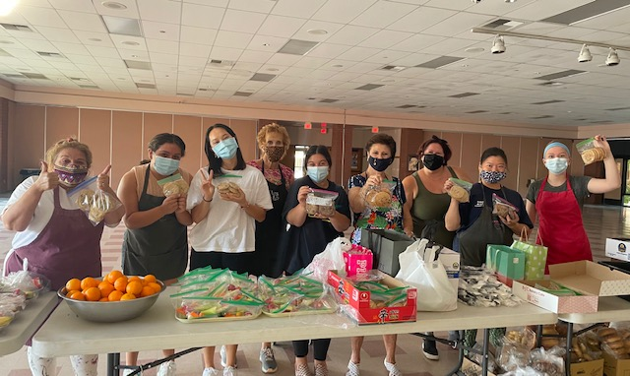
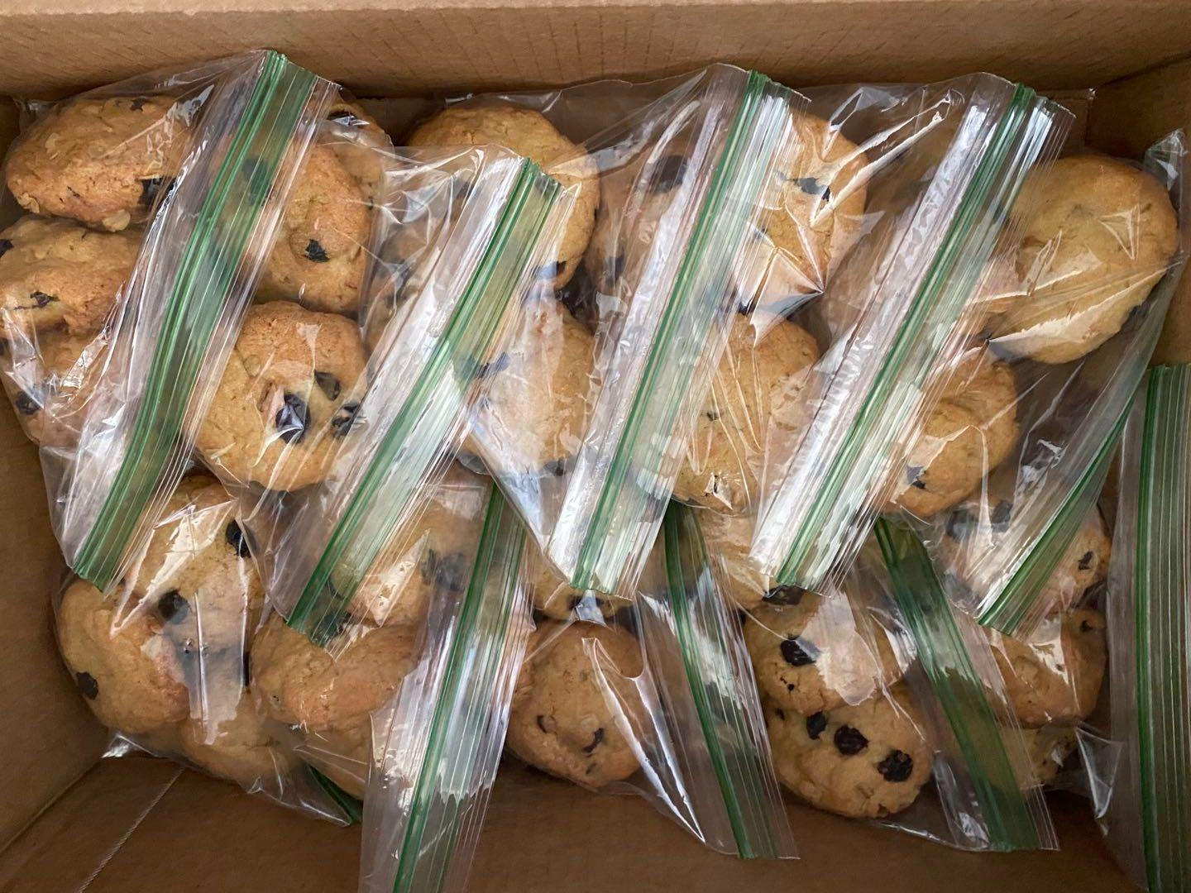
CAPA Youth Team Cookie Program
100+ bags of cookies total delivered/week
Locations: St. Andrew's Episopal Church and Bread of Angels (Fullerton & Brea)
10 bags/student -> 200 recorded volunteer minutes
Notes:
Bella

Slide 12
Be Your Own Project Leader
Notes:
CAPA Youth Team is accepting applications for projects. You can be your own team leader. Project applications will be reviewed by CAPA board members and upon approval of the project, CAPA can support your project by providing resources. The scope of your project needs to adhere to CAPA terms and guidelines, Check www.dbhscapa.com for more information.

Slide 13
Q&A- By Cindy Huang, CAPA President
Please type any questions you may have in the chat

