Slide 1
CAPA – DBHS Hosts Student Club Rush Q&A
6:00 PM – 6:30 PM
Host: Mavis Chen, Vice President
Student Speakers: Adelyn Woo & Ashlyn Woo

Slide 2
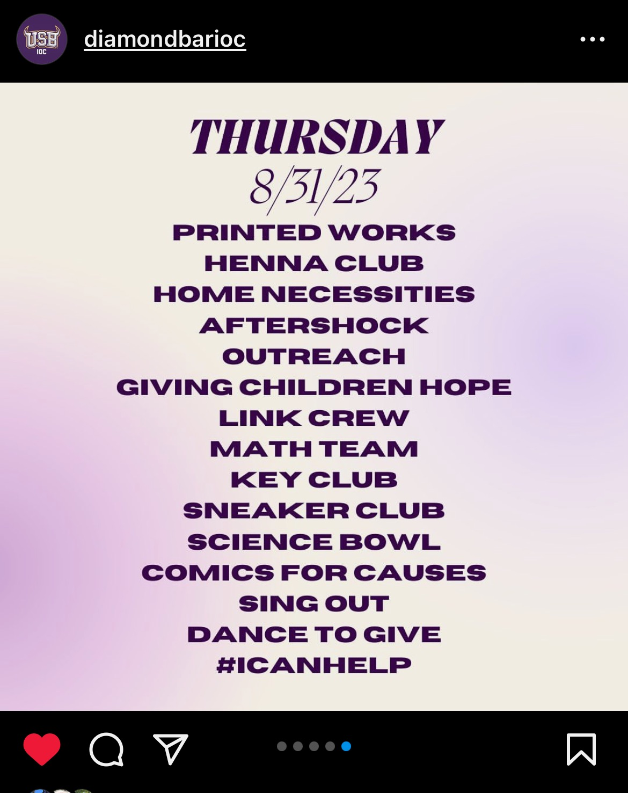
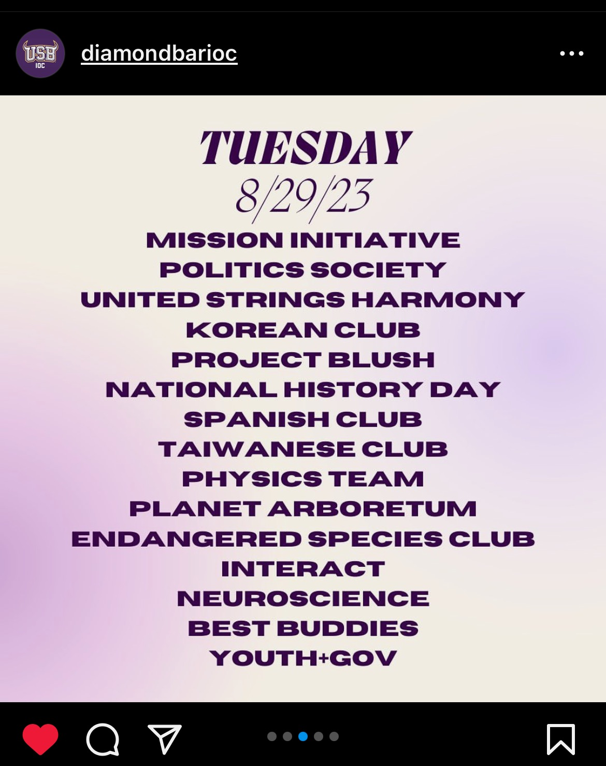
Club Rush Week 1 8/28 – 8/31

Slide 4
CAPA Student Mentor Project

Slide 5
Q&A with Ashlyn Woo Class of 2021
Importance of Activities & Clubs
Leadership Experience
Prepare for College

Slide 6
Thank you!
To join CAPA Membership, contact Mavis Chen in WeChat or WhatsApp.

